Slide 1

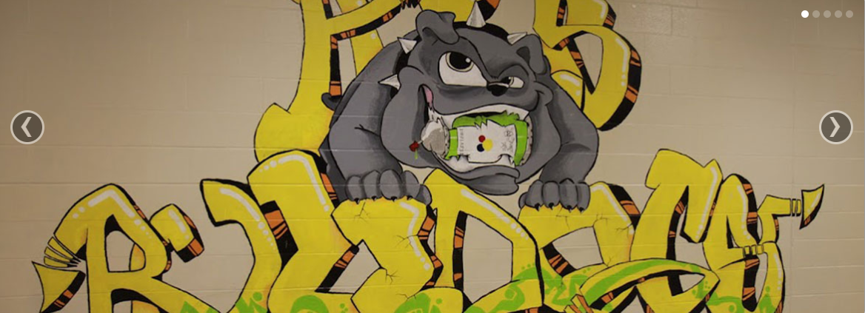
A.L. STANBACK MIDDLE SCHOOL BOOSTERS
Home of the Bulldogs
3700 NC 86 S Hillsborough, NC 27278
919.644.3200
919.644.3226
Home
About Us
Sign In/Register
Profile
Contact Us
WELCOME TO THE A.L. STANBACK BOOSTERS

Slide 2
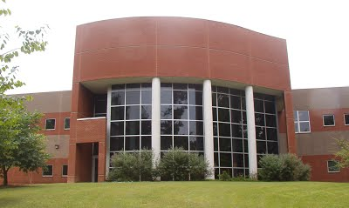
A.L. STANBACK MIDDLE SCHOOL BOOSTERS
Home of the Bulldogs
3700 NC 86 S Hillsborough, NC 27278
919.644.3200
919.644.3226
Home
About Us
Sign In/Register
Profile
Contact Us
About Us
Welcome Parents! This is the AL Stanback Boosters website. After registering with the site, you can add your children and enroll them in sports and other extracurricular activities. You can also be one of our generous “Top Dog” donators to help out the boosters program. Visit the Contact Us page to learn more!

Slide 3
A.L. STANBACK MIDDLE SCHOOL BOOSTERS
Home of the Bulldogs
3700 NC 86 S Hillsborough, NC 27278
919.644.3200
919.644.3226
Home
About Us
Sign In/Register
Profile
Contact Us
Don’t have an account?
Have an account?
Register
Sign-In
E-mail
E-mail
Enter email
Enter email
Password
Password
Enter password
Enter password
Confirm Password
Sign In
Enter password
Register

Slide 4

A.L. STANBACK MIDDLE SCHOOL BOOSTERS
Home of the Bulldogs
3700 NC 86 S Hillsborough, NC 27278
919.644.3200
919.644.3226
Home
About Us
Sign In/Register
Profile
Contact Us
Hello, Sharon!
Personal Information
Children
Name:
Sharon Whitaker
Phone Number:
(919) 867-5309
Address:
1409 Dodsons Crossroads,
Chapel Hill, NC 27516
Jacob Whitaker
Football, Wrestling
Rachael Whitaker
Cross Country, Chorus
Chelsea Whitaker
Volleyball, Band, Track

Slide 5
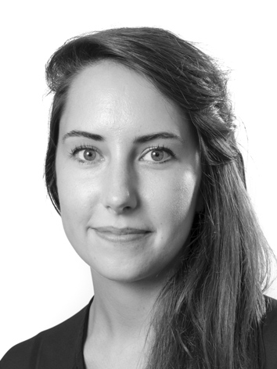


A.L. STANBACK MIDDLE SCHOOL BOOSTERS
Home of the Bulldogs
3700 NC 86 S Hillsborough, NC 27278
919.644.3200
919.644.3226
Home
About Us
Sign In/Register
Profile
Contact Us
If you would like more information on how to support the ALS boosters, please contact us here!
Our “Top Dog” Donators
Name
Tammy Williams
Enter name
E-mail
Enter email
Scott Defrank
Message
Enter message…
Alexis Jones
Send

Slide 6
FUNCTIONALITY

Slide 7
HOME

Slide 8

A.L. STANBACK MIDDLE SCHOOL BOOSTERS
Home of the Bulldogs
3700 NC 86 S Hillsborough, NC 27278
919.644.3200
919.644.3226
Home
About Us
Sign In/Register
Profile
Contact Us
WELCOME TO THE A.L. STANBACK BOOSTERS

Slide 9
A.L. STANBACK MIDDLE SCHOOL BOOSTERS
Home of the Bulldogs
3700 NC 86 S Hillsborough, NC 27278
919.644.3200
919.644.3226
Home
About Us
Sign In/Register
Profile
Contact Us
WELCOME TO THE A.L. STANBACK BOOSTERS

Slide 10
ABOUT US

Slide 11
A.L. STANBACK MIDDLE SCHOOL BOOSTERS
Home of the Bulldogs
3700 NC 86 S Hillsborough, NC 27278
919.644.3200
919.644.3226
Home
About Us
Sign In/Register
Profile
Contact Us
About Us
Welcome Parents! This is the AL Stanback Boosters website. After registering with the site, you can add your children and enroll them in sports and other extracurricular activities. You can also be one of our generous “Top Dog” donators to help out the boosters program. Visit the Contact Us page to learn more!

Slide 12
SIGN-IN/REGISTER

Slide 13
A.L. STANBACK MIDDLE SCHOOL BOOSTERS
Home of the Bulldogs
3700 NC 86 S Hillsborough, NC 27278
919.644.3200
919.644.3226
Home
About Us
Sign In/Register
Profile
Contact Us
Don’t have an account?
Have an account?
Register
Sign-In
E-mail
E-mail
Enter email
Enter email
Password
Password
Enter password
Enter password
Confirm Password
Sign In
Enter password
Register

Slide 14
A.L. STANBACK MIDDLE SCHOOL BOOSTERS
Home of the Bulldogs
3700 NC 86 S Hillsborough, NC 27278
919.644.3200
919.644.3226
Home
About Us
Sign In/Register
Profile
Contact Us
Don’t have an account?
Have an account?
Register
Sign-In
E-mail
E-mail
Enter email
Must be a valid email address!
Enter email
Password
Password
Enter password
Enter password
Confirm Password
Sign In
Enter password
Register

Slide 15
A.L. STANBACK MIDDLE SCHOOL BOOSTERS
Home of the Bulldogs
3700 NC 86 S Hillsborough, NC 27278
919.644.3200
919.644.3226
Home
About Us
Sign In/Register
Profile
Contact Us
Don’t have an account?
Have an account?
Register
Sign-In
E-mail
E-mail
Enter email
Enter email
Password
Password
Enter password
Passwords must be:
-At least 8 characters long
-Use at least 1 special character and 1 number
-Have at least 1 capital letter
Enter password
Confirm Password
Sign In
Enter password
Register

Slide 16
A.L. STANBACK MIDDLE SCHOOL BOOSTERS
Home of the Bulldogs
3700 NC 86 S Hillsborough, NC 27278
919.644.3200
919.644.3226
Home
About Us
Sign In/Register
Profile
Contact Us
Don’t have an account?
Have an account?
Register
Sign-In
E-mail
E-mail
Enter email
Enter email
Password
Password
Enter password
Enter password
Confirm Password
Sign In
Enter password
Passwords must match!
Register

Slide 17
A.L. STANBACK MIDDLE SCHOOL BOOSTERS
Home of the Bulldogs
3700 NC 86 S Hillsborough, NC 27278
919.644.3200
919.644.3226
Home
About Us
Sign In/Register
Profile
Contact Us
Don’t have an account?
Have an account?
Register
Sign-In
E-mail
E-mail
Enter email
Enter email
Password
Password
Enter password
Enter password
Confirm Password
Sign In
Enter password
We don’t recognize that Email/Password combination, please try again!
Register

Slide 18
PROFILE

Slide 19
A.L. STANBACK MIDDLE SCHOOL BOOSTERS
Home of the Bulldogs
3700 NC 86 S Hillsborough, NC 27278
919.644.3200
919.644.3226
Home
About Us
Sign In/Register
Profile
Contact Us
Hello, Sharon!
Personal Information
Children
Name:
Sharon Whitaker
Phone Number:
(919) 867-5309
Address:
1409 Dodsons Crossroads,
Chapel Hill, NC 27516
Jacob Whitaker
Football, Wrestling
Rachael Whitaker
Cross Country, Chorus
Chelsea Whitaker
Volleyball, Band, Track

Slide 20

A.L. STANBACK MIDDLE SCHOOL BOOSTERS
Home of the Bulldogs
3700 NC 86 S Hillsborough, NC 27278
919.644.3200
919.644.3226
Home
About Us
Sign In/Register
Profile
Contact Us
Hello, Sharon!
Personal Information
Children
Name:
Sharon Whitaker
Phone Number:
(919) 867-5309
Address:
1409 Dodsons Crossroads,
Chapel Hill, NC 27516
Jacob Whitaker
Football, Wrestling
Rachael Whitaker
Cross Country, Chorus
Chelsea Whitaker
Volleyball, Band, Track

Slide 21
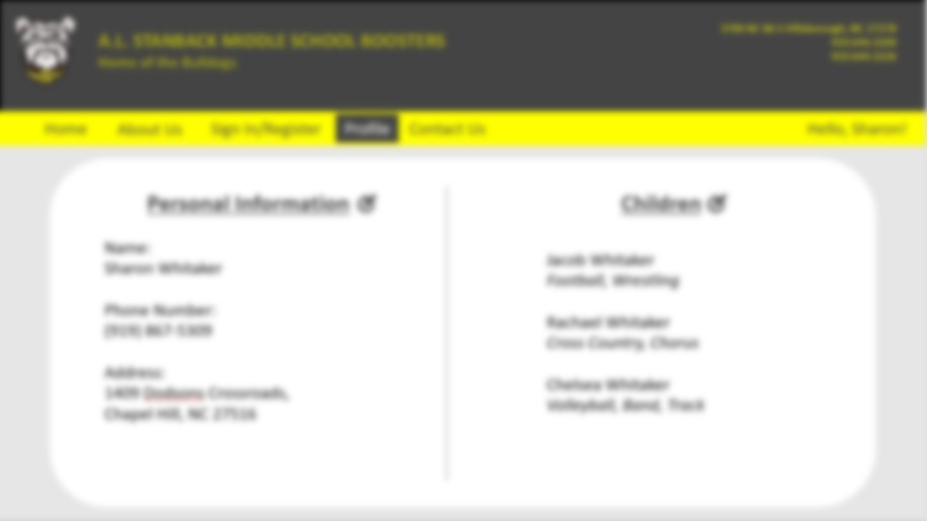
Personal Information
Name
Enter name
Phone Number
Enter phone number
Address
Enter address
Submit

Slide 22
A.L. STANBACK MIDDLE SCHOOL BOOSTERS
Home of the Bulldogs
3700 NC 86 S Hillsborough, NC 27278
919.644.3200
919.644.3226
Home
About Us
Sign In/Register
Profile
Contact Us
Hello, Sharon!
Personal Information
Children
Name:
Sharon Whitaker
Phone Number:
(919) 867-5309
Address:
1409 Dodsons Crossroads,
Chapel Hill, NC 27516
Jacob Whitaker
Football, Wrestling
Rachael Whitaker
Cross Country, Chorus
Chelsea Whitaker
Volleyball, Band, Track

Slide 23
Children
Number of Children
0
Additional Emergency Contact
Enter name
Enter phone number
Submit

Slide 24
Children
Number of Children
0
1
2
3
4
5
6
Additional Emergency Contact
Enter name
Enter phone number
Submit

Slide 25
Children
Number of Children
2
Child #1
Child #2
Additional Emergency Contact
Enter name
Enter phone number
Submit

Slide 26
Children
Number of Children
2
Child #1
Name
Enter name
Birthdate
mm/dd/yyyy
Sports/Activities
Football
Wrestling
Lacrosse
Basketball
Track
Volleyball
Cross Country
Baseball
Chorus
Band
Cheerleading
Child #2
Additional Emergency Contact
Enter name
Enter phone number
Submit

Slide 27
CONTACT US

Slide 28
A.L. STANBACK MIDDLE SCHOOL BOOSTERS
Home of the Bulldogs
3700 NC 86 S Hillsborough, NC 27278
919.644.3200
919.644.3226
Home
About Us
Sign In/Register
Profile
Contact Us
If you would like more information on how to support the ALS boosters, please contact us here!
Our “Top Dog” Donators
Name
Tammy Williams
Enter name
E-mail
Enter email
Scott Defrank
Message
Enter message…
Alexis Jones
Send

